Slide 1
Everything you wanted to know about fiber but were afraid to ask
Mark Boxer
Applications Engineering Manager
OFS
Cell: 252 495 4131
mboxer@ofsoptics.com

Slide 2
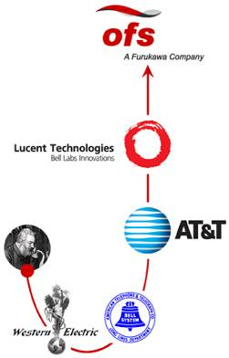
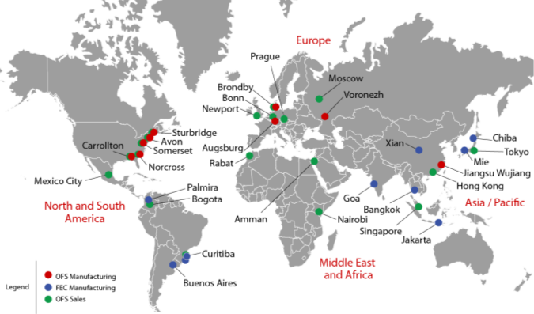
OFS – Stable, Reliable, Customer Focused
Worldwide Resources
OFS and Furukawa Global Reach

Slide 3
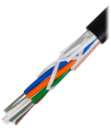
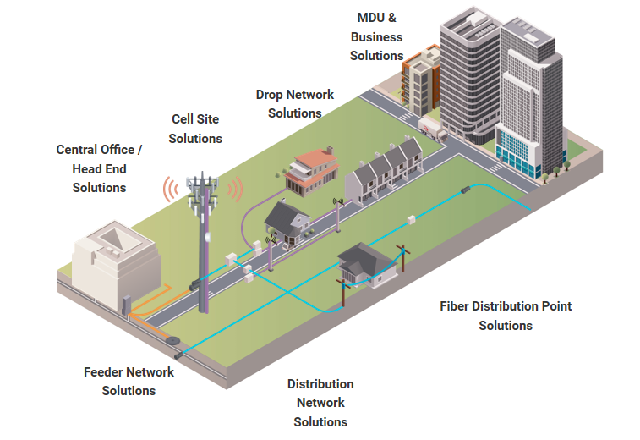
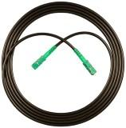
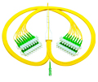

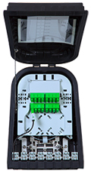

Product and service solutions for the entire network

Slide 4
Why Fiber?
1
Fiber is future proof
4

Slide 5
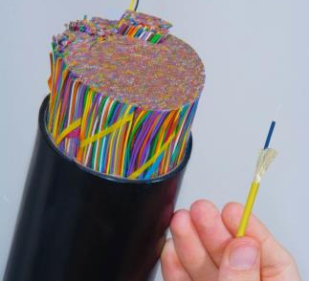
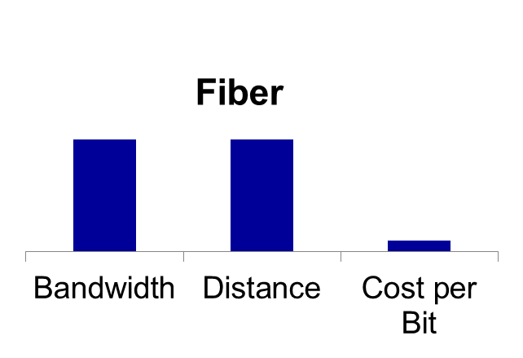
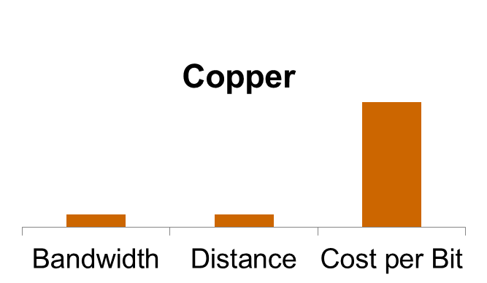
Why Fiber?
More bandwidth, longer distance, more reliable, lowest cost per bit
2400 Pair
Copper Cable
100 Gbps to 1 KM
1 Fiber Cable
>50 Tbps
>5000 KM
Notes:
In the past large and heavy copper cables were the mainstay of telecommunication distribution networks and provided limited bandwidth.
Optical fiber cables increased the bandwidth significantly at the same time that required much less space.
OFS takes a new leap by offering mini cables with AllWave fiber and increases bandwidth capacity with relatively lower cost.
Duct Sizes:
Copper cable: 110mm
Sta Loose Tube: 32/40mm Europe (20/25mm BT)
MiDia: 8/10mm (10/12mm)

Slide 6
Technology evolution
 | Copper | Wireless - Cellular | Fiber
Mid-20th century | Phone grade copper
Early 1980s |  | 1G -2G | Single-mode fiber introduced in early 1980s, still viable and compatible today, 100 Gbps+
Early 1990s | Category 3
1995 | Cat 5
1999 | Cat 5E | 2G-3G
2002 | Cat 6
2009 | Cat 6A
 |  | 4G
2016 | Cat 8
2019 |  | 5G
How Long Will Your Building Last?
Single-mode fiber stands the test of time.
6

Slide 7
Fiber - the core of most phone, cable, power networks
Fiber ring
Node
Cabinet
Substation
Node
Cabinet
Substation
Fiber
Copper
Coax
Wireless
Node sizes continue to fall
FTTH = Node size = 1
7

Slide 8
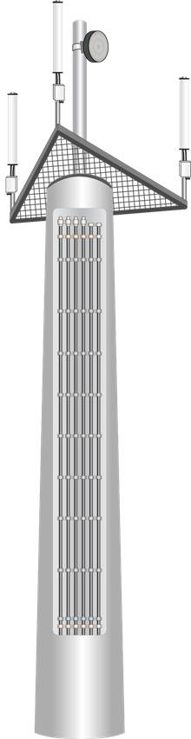


Wireless loves fiber (and vice versa)
Fiber ring
Wireless
8

Slide 9
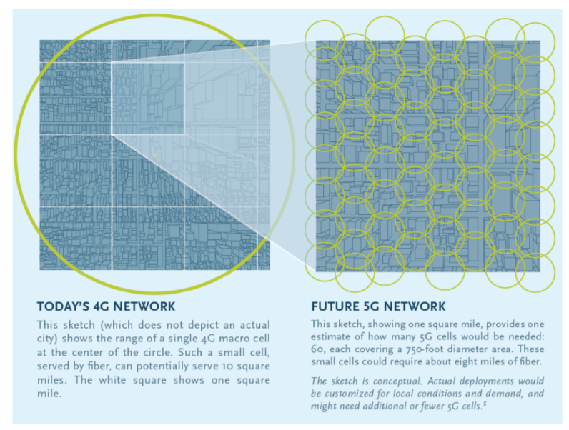
What about 5G? There is no 5G without fiber
To cover top 25 US Metropolitan Areas
10.4M small cells
750 foot diameter per cell
60 cells per square mile
8 miles of fiber per square mile
Multi-Decade Buildout
Notes:
We don’t expect next year, no business case to support this
Minimum DL link 20 GBPS
Numbers on fiber
Data from congress mobility report

Slide 10
Why Fiber?
2
Fiber attracts
Residents and businesses decide where to locate based on quality of broadband.
10

Slide 11
FTTH increases home values
SOURCE: FTTH COUNCIL INFOGRAPHIC
THE FIBER EFFECT
Access to fiber in your neighborhood
raises the value of your home by
1.3%

Slide 12
Why Fiber?
3
Fiber is simpler.
12

Slide 13
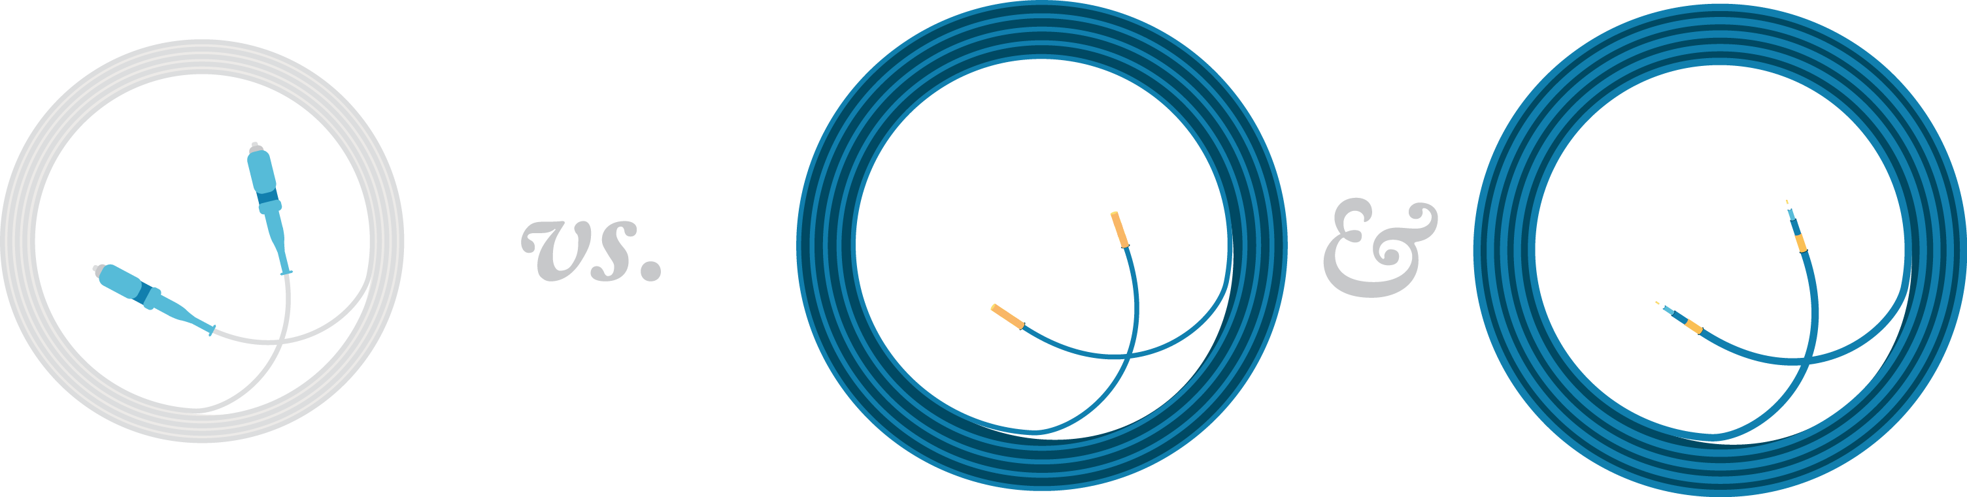
Install one cable instead of two
Fiber
TV & Voice & Data
Coaxial
Copper
13

Slide 14
Why Fiber?
4
Fiber is easier to install and less expensive.
14

Slide 15
Price of fiber
100
5
1990
2010s
15

Slide 16
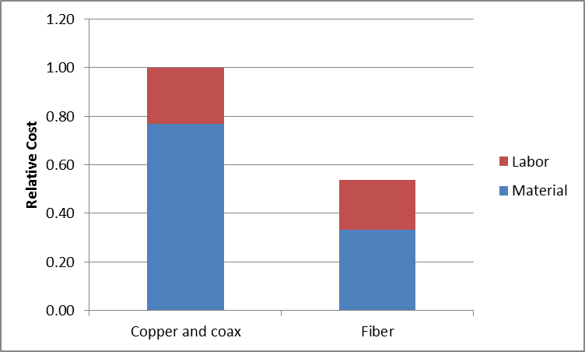
Cost comparison
Metal cables vs. fiber in a building

Slide 17
5
Fiber is less intrusive and easier to install.

Slide 18
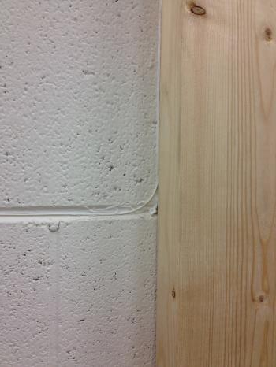
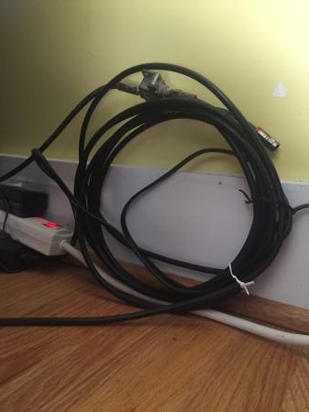
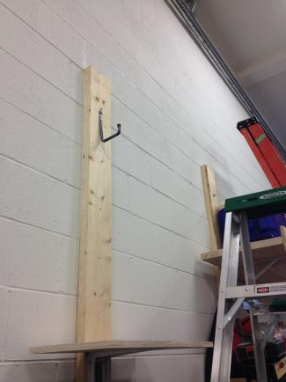
Fiber is less intrusive and easier to install

Slide 19
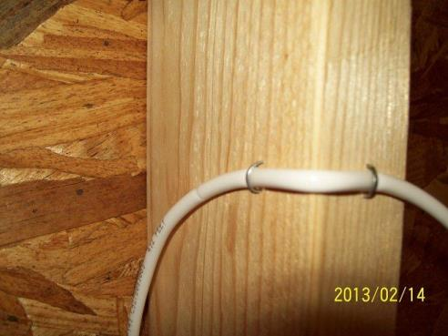
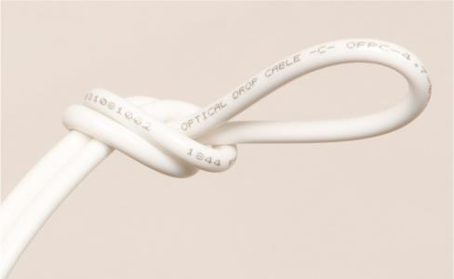
Fiber is rugged and reliable

Slide 20

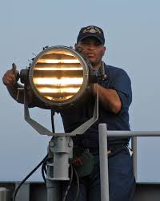
Light as a Communications Method
Used for hundreds of years
Morse code with light
Smoke Signals
Notes:
Light has been used as a communications method for hundreds of years. Examples of this are smoke signals and the use of Morse code by blinking lights.

Slide 21
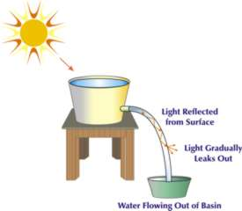

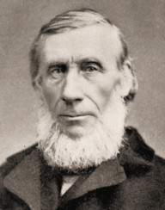
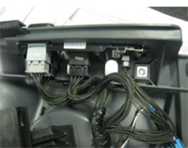
Early Pioneers of Light
John Tyndall, Jean-Daniel Colladon
Demonstrated that light could be guided within a liquid “Light Guide”
William Wheeler, 1880
Invented “Light pipes” for home lighting using reflective pipes
Similar to concept used today for interior car illumination
Jean-Daniel Colladon
John Tyndall
1841
1870
Photos courtesy of Larry Johnson, Fiber Story
Notes:
John Tyndall and William Wheeler demonstrated that light could be guided.
John Tyndall showed that light could be guided in a steam of water from a bucket.
William Wheeler invented the concept of light pipes for home lighting. We use that concept today for car interior illumination.

Slide 22
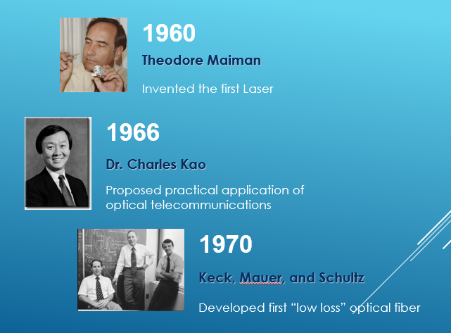
Towering figures in optical communications
Slide Courtesy of Larry Johnson, Fiber Story

Slide 23
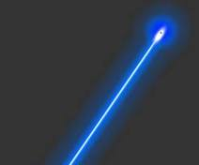
Breakthrough technologies to date
Lasers
  Invented in 1960s
Fiber manufacturing techniques
  Invented in 1970s
Single-mode fiber
  Invented in 1980s
Quality, process, and cost improvements
  1980s through present
FTTH
  Deployments in volume in 2000s
Notes:
Breakthroughs really began to take place in the 1960s and 1970s. Lasers were invented in the 1960s.
Low loss fiber manufacturing techniques were first invented in the 1970s, and single-mode fiber was introduced in the 1980s.
Since those fundamental inventions occurred, the industry has been constantly reinventing itself with new innovations, and a wide variety of quality, process and cost improvements starting in the 1980s and continuing today.
The cost of fiber has dropped dramatically approximately 95% from the early days, and the quality far exceeds fibers from the early years.
These quality and cost improvements have enabled fiber to take its position as a preferred communication medium throughout a wide variety of networks, including FTTH.
Although FTTH trials have occurred since the early 1990s, FTTH momentum really picked up from 2005 to 2010 to the point now that most new network builders choose fiber as their first choice, due to its combination of high bandwidth and low cost.

Slide 24
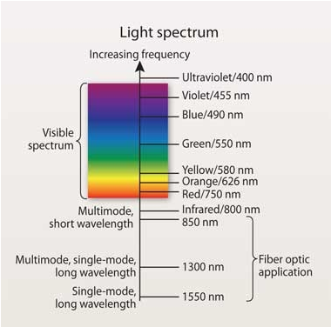
The light spectrum
Fiber uses light for communication
This light is operated at non-visible wavelengths longer than visible light
Image from Siemon/CI&M Magazine

Slide 25
Optical Fiber
Fastest communications pipe available
Coating
Light ray
Cladding
Core
Light travels in core and bounces off of the cladding
Plastic coating protects pure silica (glass) cladding
1 fiber can handle hundreds of millions of telephone calls at once
Notes:
Now we’ll start to get into some more technical topics. Fiber is the fast communications pipe available.
It’s often referred to as a “light pipe” since the fiber contains light. A common question is whether the center is hollow.
A fiber is made of glass and most types are completely solid. Some experimental fibers have holes in them, but they’re not used for common telecommunications purposes.
The difference between the core and the cladding is that the core has dopant material to the glass.
Fibers have plastic coatings on them to protect them, which we’ll talk about later in this presentation.
Finally, one fiber can handle hundreds of million telephone calls at one time.

Slide 26
Total Internal Reflection – Snell’s Law
n₂
Critical angle
n₁
CORE
Reflected Light
Incoming Light
CLADDING
Notes:
The basic concept of total internal reflection is what makes fibers work.
Light travels down the core and bounces off of the cladding as it makes its way down the fiber.
The core and the cladding have different indices of refraction. The refractive index difference is what makes fibers work.
We’ll talk more about total internal reflection in the next few slides.

Slide 27
Fiber Structure
125 microns
Core - The center of an optical fiber. Contains dopants to change speed of light.
Cladding - Outer layer of glass to contain light. Different refractive index.
Coating - Cushions and protects fibers.
Standard - ITU G.652 is a starting point
v
v
v
3-100 microns
250 microns
Notes:
As I mentioned earlier in the presentation, a fiber is made of solid glass.
The glass is extremely pure. We measure the impurities in the glass raw materials down to the parts per billion level.
To put that in perspective, there are approximately 1.1 billion people in Africa. You’d have a better chance of finding a particular person on the continent of Africa than you would finding an impurity during a random sampling of the raw materials we use for our fiber.
The core is the center of an optical fiber. It contains dopants to change the speed of light versus the cladding. The most common dopant is germanium dioxide, GeO2.
The core of telecommunications fibers can be anywhere from roughly 3 to 100 microns, but the most common single-mode fiber has a core of around 9-10 microns. The core is the dark blue dot in the picture.
The cladding is an outer layer of glass, and it is typically 125 microns, or a little larger than human hair. It’s made of pure silica dioxide, SiO2, otherwise known as glass.
Finally, there are 2 layers of plastic coatings on the outside of the glass that cushion and protects the fiber. The inner layer is larger, and is softer. The outer layer is smaller and is tougher. These coatings bring the final diamter of the fiber to approximately 245-250 microns.

Slide 28
Types of fibers: Single-mode and Multimode
Index of refraction profiles
8-10 µm
Singlemode
125 µm
cladding
core
50-62.5 µm
Multimode
125 µm
Notes:
There are 2 main types of telecommunications fibers, single-mode and multimode.
For long distances telecommunications networks, single-mode fiber is the most common. It’s shown on the top picture, and you can see the refractive index profile on the right side of the slide. It looks like a step.
Multimode fiber is used for short distance applications, typically less than 2 km. Multimode has a parabolic graded index of refraction profile.
We’ll talk through the differences in the next few slides.

Slide 29
Single Mode Fiber
Small core only allows
one mode of light
Single-mode of light eliminates “modal dispersion” enabling ultra high bandwidth over long distances
Low attenuation enables very long distance support (typically< 0.2-0.3 dB/km @1550 nm)
Used for most networks over 2 km (6500’)…longer distances
Notes:
As we’ve already discussed, single-mode fiber is the most common form of fiber for most long distance networks.
True to its name, single-mode fiber has a smaller core size, which allows only mode of light to propagate at one time. Having only one mode of light eliminates the modal dispersion that we have in multimode fibers, giving single-mode fiber ultra high bandwidth.
It also has ultra low attenuation , which makes it most suitable for long distance networks.
As we talk further about fiber, for FTTH and other applications, the fibers we’ll be talking about are single-mode fibers.

Slide 30
Single-mode Fiber Geometry
In single-mode fibers only, not all light is in the core
Some power is in the cladding
The area where 95% of the light is carried is called the “Mode Field Diameter (MFD)
Secondary Coating (245-250 microns)
Glass Diameter (125 microns)
Mode Field Diameter (9-10 microns)
Core Diameter (Appx. 8 microns)
Notes:
This is a close up look at single-mode fiber geometry.
The core is roughly 8 microns, and the MFD is approximately 9.2 microns. It’s actually 9.2 microns at 1310 nm, but 10.4 microns when 1550 nm light is used.
Outside of the core and mode field diamteer, the glass diameter is 125 microns. The primary coating is roughly 180-200 microns, and the secondary coating is around 240-250 microns.
Fiber geometry is a very important parameter, and you want to buy fiber from a supplier that has very tight control of fiber geometry. If fiber geometry is not good, the network can have different types of problems from elevated splice loss to polarization mode dispersion issues, which we’ll talk about later in this presentation.

Slide 31
Attenuation
dB | Power through
0.3 | 93%
0.4 | 91%
3.0 | 50%
The loss of light power over distance
Measured in dB/km
Depends on wavelength
dB = 10 log (Power out / Power in)
Notes:
Attenuation is the loss of light power over distance. It is measured in dB/km. Something that’s interesting is that the attenuation in the system depends on the wavelength being transmitted.
Common wavelengths are 1310 nm and 1550 nm. The loss at 1310 nm is typically around 0.35 dB/km, and the loss at 1550 nm is typically less than 0.25 dB/km. However, as we’ll see later in the presentation, it’s very important to have a fiber that has low loss across the entire optical spectrum.

Slide 32
Attenuation Mechanisms
Absorption
  Glass and dopants
Scattering
  Impurities
Microbending
  Cabling or other stresses
Macrobending
  Sharp bends
Microbend
Scattering
Absorption
Macrobend
Notes:
There are several mechanisms that cause attenuation.
First, the glass and dopants can absorb light. We’ll talk a little later about the water peak, and an attenuation increase around 1383 nm. That’s caused by an absorption mechanism.
A second attenuation mechanism is scattering, where very small impurities and the inherent structure of the glass may cause the light to scatter.
Bending is another mechanism that causes attenuation. There are two types of bending issues.
Microbending occurs due to point stresses that are placed on the fiber, and macrobending is due to tight bends. We’ll talk about both later in this presentation.

Slide 33
Intrinsic Attenuation - Rayleigh Scattering Loss
Caused by variations in the density of the glass
scattered light
transmitted
light
changes in refractive index
A ≈1/λ⁴
Notes:
We talk about both “Intrinsic” and “extrinsic” attenuation sources.
Rayleigh scattering is what causes the baseline attenuation of a fiber, and the attenuation of fiber due to Rayleigh scattering changes over the wavelength range with a 1/λ^4 relationship.

Slide 34
Extrinsic Attenuation
“Microbend”
Lateral Stress
Refracted
Reflected
Notes:
Bending is an extrinsic attenuation mechanism.
As we mentioned in the first slide of this section, microbending occurs when a point stress presses on the fiber.

Slide 35

Macrobending
Conventional Single-mode fiber
High optical loss around bends
Bend Optimized
Singlemode fiber
Large Optical Loss
Small
Small
Small
radius
radius
Optical Signal
radius
Service
Maintained
Dysfunctional Signal exits bend
Service Disrupted

Slide 36
Bend loss vs wavelength and radius
Optical Fiber Bending Loss Increase vs Wavelength
Macrobending Loss of typical standard G.652D SMF
Single 360 degree turn (maximum loss)
20
15
10 mm radius
std SMF
Macrobending Loss (dB)
7.5 mm radius
10
std SMF
5
5 mm radius
std SMF
0
1260
1280
1300
1320
1340
1360
1380
1400
1420
1440
1460
1480
1500
1520
1540
1560
1580
1600
1620
Wavelength (nm)
Bending loss of Std SMF (G.652D) can disrupt services or reduce reach
Notes:
To illustrate how important bending performance is to the network, this graph shows what happens when we bend a standard single-mode fiber to different bend diameters. Note that as the diameter gets tighter, the loss also gets higher.
Also note that as wavelengths get longer, the loss gets higher. This is why for systems with many bends, we often recommend the use of bend insensitive fibers.

Slide 37
Bending Loss will become an even Bigger Challenge
Application | Standard | Current Generation |  | Next Generation on Same Fiber Network |  | Bending Loss Increase
FTTH | IEEE | GE-PON downstream | 1490 nm | 10G E-PON downstream | 1577 nm | 3X
 | ITU-T | G-PON Downstream |  | 10G-PON downstream
 |  |  |  | 40G-PON (NG-PON2) | 1603 nm | 4X
DOCSIS and HFC | SCTE /ITU | RF-Video downstream | 1550 nm | RFoG upstream | 1610 nm | 2X
Metro and some Long Haul | ITU | C-Band DWDM /CWDM | 1560 nm | L-Band DWDM /CWDM | 1625 nm | 2.5X

Slide 38


ITU-T G.657 Bend Loss Insensitive SM Fiber
Minimum design radius | ITU-T G.657 Fiber Standard
10 mm Bend Challenged OSP Cable | G.657A1
7.5 mm Most Connectivity Applications | G.657A2
5.0 mm In Home/MDU Drop | G.657B3

Slide 39
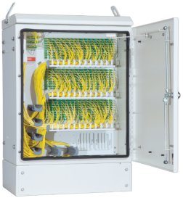
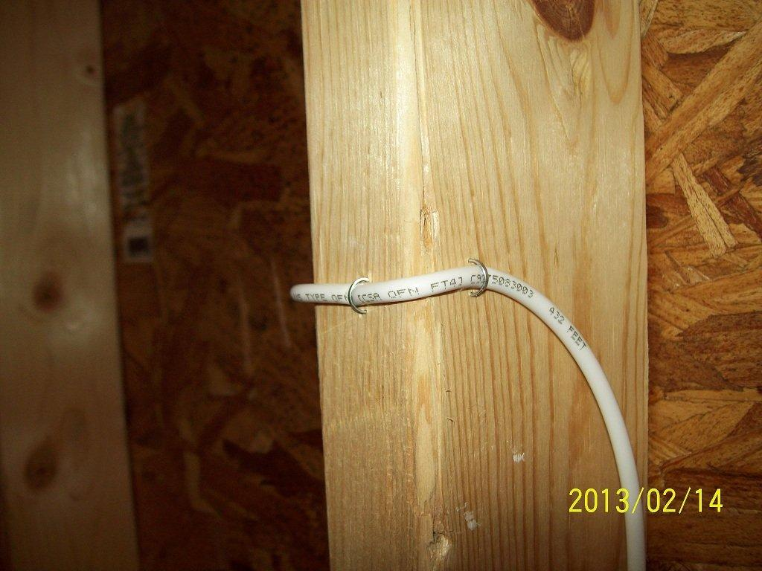
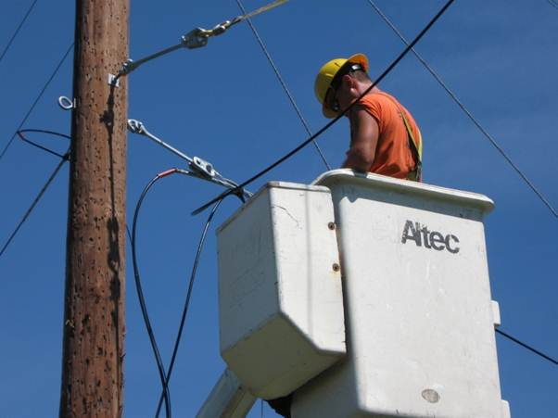
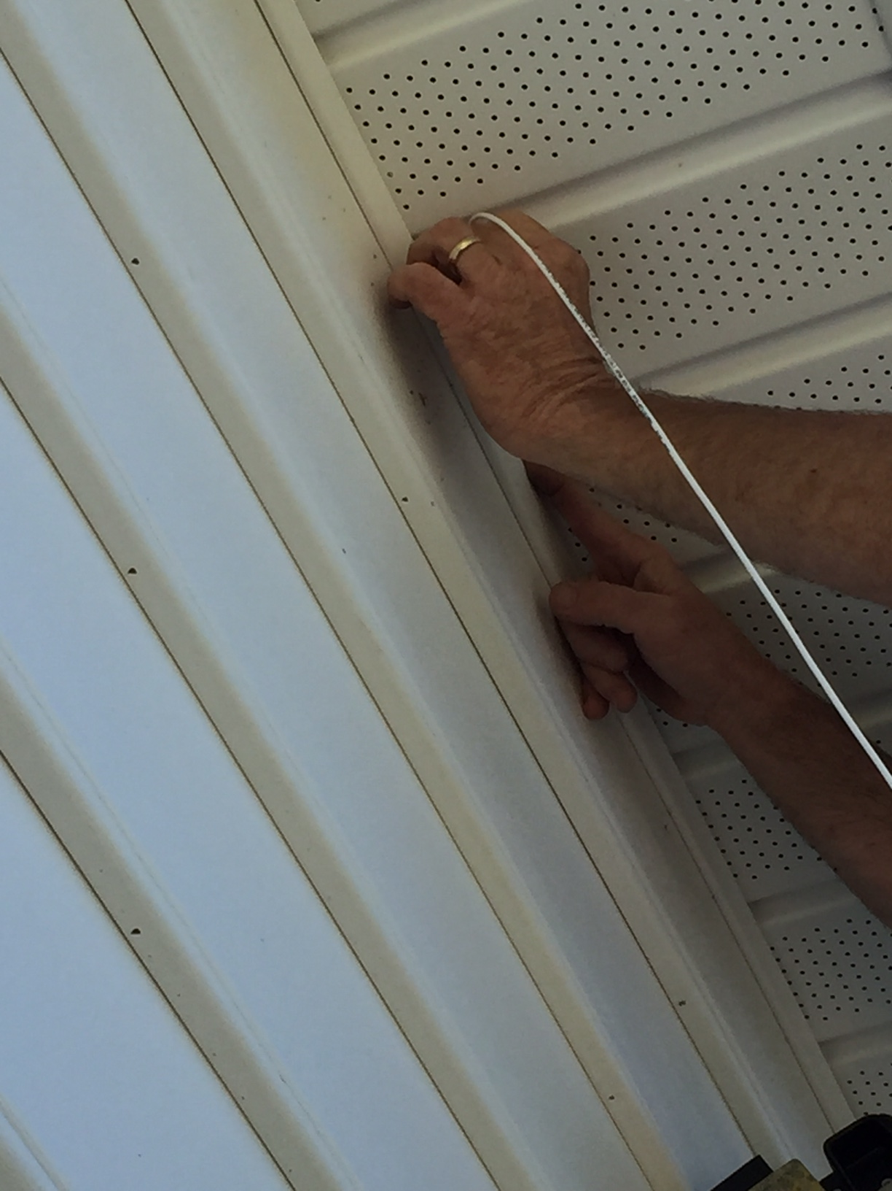

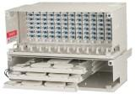
Different fiber types do different jobs
Cabinets, boxes,
closures
In homes and buildings
Network core and drops
G.652.D/G.657A1
G.652.D/G.657A2
G.657B3

Slide 40
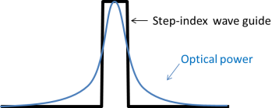
What makes Bend Insensitive Fiber special?
Standard Single-mode fiber
Allows light to leak out during bending
Bend insensitive fiber
More complex profile captures light
Representative index of refraction profiles (not exact)

Slide 41
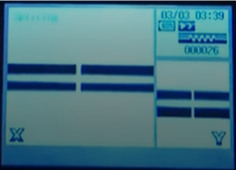
Different fibers can be spliced
Single-mode fibers from different manufacturers can be spliced together
G.652D and G.657 can be spliced together
Fibers with different mode field diameters may show a “gainer”
  These don’t typically affect network performance
Do not splice single-mode to multimode fibers together

Slide 42
Intrinsic Attenuation - “Absorption”
Natural impurities (OH ions) in the glass absorb light energy
1 ppm causes 40 dB/km loss @ 1383 nm
Notes:
Another intrinsic attenuation mechanism we mentioned earlier is absorption.
Different impurities absorb light at different wavelengths. The most common impurity is the OH- ion. It absorbs light around 1383 nm, and this phenomenon is called the “water peak”. 1 ppm of OH ions can cause 40 dB/km loss @ 1383 nm.
OFS pioneered a way of removing and locking out the OH ion in the glass. We call our fiber with this technology “Zero Water Peak” technology.
Where some fiber suppliers still sell fiber with up to 1 dB/km loss at 1383 nm, OFS AllWave fiber has max loss of 0.31 dB/km, meaning that OFS fibers can transmit 3x farther than some competitors.

Slide 43
The entire optical spectrum will be needed
ITU-T Wavelength Bands (nm)
Technology
P2P & DWDM
12 ch CWDM
Year
1990s
1260 1280 1300 1320 1340 1360 1380 1400 1420 1440 1460 1480 1500 1520 1540 1560 1580 1600 1620
GE/GPON
2000s
RFoG
E-Band CWDM
2000s
10GPON
2016
NG-PON2
(40G-PON)
2018-
2020?
The first 30 years used 1310/1550 nm.
The next 30 will require the entire ITU spectrum.

Slide 44
Zero Water Peak Performance
Clean performance through the optical spectrum
1.2
O
E
S
C
L
U
wavelength (nm)
Conventional SM Fiber
G.652A/B
0.9
Loss (dB/km)
0.6
LWP fiber
0.3
Zero Water Peak fiber - lowest loss
0
1300
1400
1500
1600
ZWP - Up to 22% lower loss in the water peak region

Slide 45
Dispersion
Components of light travel at different speeds in the fiber
Causes signal distortion
Digital Systems
Pulse Spreading
input pulse
output pulse
Analog AM
Systems
Distortion
input sinusoid
output sinusoid
Notes:
Different components of light travel at different speeds in the fiber. This results in a parameter called “dispersion.
Dispersion causes signal distortion in systems, as you can see in the diagrams below.
There are different types of dispersion parameters, and we’ll talk about those in the next few slides.

Slide 46
Chromatic Dispersion
l1 +l2
l1 l2
Colors (Wavelengths) of Light
l1 l2
l1 +l2
l1 +l2
What the
detector
“sees”
l1 +l2
Color components of an input pulse travel at different speeds causing pulse broadening
Notes:
There are two main types of dispersion in single mode fibers. There’s “Chromatic” dispersion, and “Polarization Mode Dispersion”.
We’ll talk about chromatic dispersion first. Now how the pulses on the slide are broadening. That’s what dispersion does, and it ultimately limits the bandwidth of a system.

Slide 47
Polarization Mode Dispersion
Perfect Fiber
fast
Normal Fiber
slow
PMD = delay time
Different polarizations of light travel at different speeds

Slide 48
Polarization Mode Dispersion
Causes of PMD
Perfect Fiber
elliptical
cladding
elliptical
core
eccentric core
in the cladding
fast
Intrinsic
Normal Fiber
stress
elliptical
coating
eccentric fiber
in the coating
slow
PMD = delay time
Different polarizations of light travel at different speeds
bend
stress
Backhaul ≥ 10 Gbps | Access
Possible PMD impact with standard G.652 fibers | Limited impact
Extrinsic
twist
PMD is affected by cabling and installation Ask for performance specs in cable
Notes:
PMD describes what happens when different polarizations of light travel at different speeds in a fiber.
Like other electromagnetic waves, light has two polarization modes. These are shown with one traveling on the x-axis and one on the y-axis. In a fiber with that’s a perfect cylinder, both polarizations travel at the same speed and arrive at the output of the fiber at the same time. No problem. However, in the real world, the 2 polarizations don’t arrive at exactly the same time. The difference in arrival times of the two modes is called PMD and measured in the units of picoseconds.
PMD occurs because real fibers are not perfect, and have asymmetries caused either by intrinsic sources that occur during fiber manufacturing, or extrinsic sources caused by either cabling or installation. It is a very complicated mechanicsm, and often changes real-time even once the cable is installed in the field.
PMD is another optical parameter that has limited importance with FTTH systems, but is extremely important for backhaul system. Low PMD is critical for backhaul systems because it is very difficult and expensive to compensate. Once again, since manufacturers sell fiber with different grades, it’s important to know what’s actually in the cable to make sure it’ll meet your long-term needs.

Slide 49
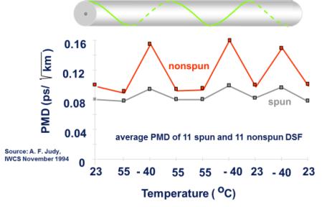
Spinning Fibers
Reduces PMD and improves PMD stability
Notes:
To reduce PMD and to make PMD more resistant to external perturbations, TrueWave fiber is manufactured with a patented spinning process.
Fibers are spun in an oscillatory manner (“SZ”) to impart several twists per meter. This spinning introduces high mode coupling into the fiber. This reduces PMD and makes the fiber less sensitive to external environmental effects.
To demonstrate the improved stability of spun fibers, a 22-fiber cable was manufactured that contained 11 spun fibers and 11 nonspun fibers.
The cable was placed into a temperature chamber and temperature cycled.
The data above shows the average PMD value for the 11 spun fibers and the 11 nonspun fibers at each temperature. The spun fibers are much more stable.

Slide 50
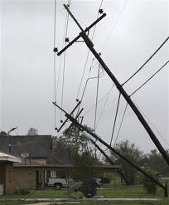
Fiber Mechanical Reliability

Slide 51
Fiber strength
Glass is stronger than steel!
Coating performance is an integral part of fiber strength performance
When designed and installed properly, fiber can last for decades
800 kpsi strength!
Notes:
Glass in optical fibers appears to be somewhat fragile . However, this is only because the diameter of the glass is so small.
Diameter to diameter, glass is actually stronger than steel.
When the glass is drawn from the tower, it is bare, so a coating is applied. The coating performance is very important to preserving the strength of the fiber.
When designed and installed properly, fiber has proven that it can last for decades in aerial or underground environments.

Slide 52

How pure is OFS glass?
Raw material impurities measured in parts per billion
Roughly 3x more likely to win Powerball than find impurities in the fiber core

Slide 53
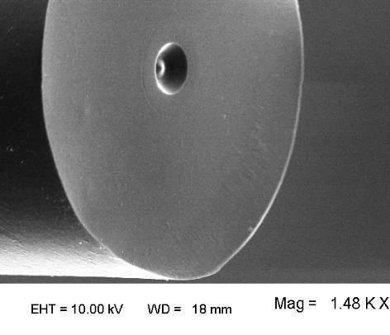
High Purity Synthetic Silica VS. Natural Quartz
OFS Advantage:
Glass Material | 100% pure synthetic silica | ✓
Figure 2. Cheap natural quartz raw material fiber clearly shows many pits and imperfections .
“Acne like” condition shows difference between pure and clean synthetic quartz vs natural quartz with its impurities and inclusions.
Figure 1. High purity synthetic silica fiber
Figures 1 and 2 show SEM micrographs of fiber end-faces. In both cases the cleaved fiber surface was briefly etched in acid (48% HF for 3 minutes).

Slide 54
Fiber strain
Limiting fiber strain drives all mechanical reliability calculations
< 0.2% long-term strain targeted for negligible crack growth
  Higher allowable for short periods of time
Serves as cable tension limitation –
  Maximum Rated Cable Load (for ADSS)
  Max Installation Tension (for duct/underground cables)
Fiber has become well known for outstanding reliability – due to this limitation
Tension
< 0.2% strain

Slide 55
Dynamic Fatigue
All glass has flaws
100% synthetic silica reduces the number of flaws
“N_{d}”Measure how flaws grow in the presence of stress
  Installation, weather or other conditions
Test is performed in tension
  Results influenced by coating glass combination
Expressed as nd, dynamic fatigue parameter (min = 18)
  Higher is better, Stable is very important
Time
Strength
Time
Strength
Installation 100 KPSI
14 years 34 KPSI
8 years 82 KPSI
19 years broken
Installation 100 KPSI
14 years 84 KPSI
19 years 73 kpsi
8 years 91 KPSI
Lower nd
Higher nd

Slide 56
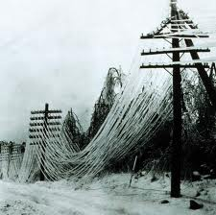

Importance of robust Dynamic Fatigue performance
Installation contractors and Mother Nature don’t always observe our rules
Robust Dynamic Fatigue provides additional performance in the face of adverse conditions
Cable tensile ratings use Dynamic Fatigue in cable design (aramid or fiberglass)
Mechanical Reliability | Dynamic fatigue performance. Excellent coating reliability | ✓

Slide 57
Summary - The fiber is the network
Many reasons fiber is going deep in the network – often to the home
Several different fiber standards
  G.652/G.657 for OSP. However, standards set only basic performance levels
Fiber performance is driven by many things
  Optical performance
    Attenuation and bend performance
    Dispersion (chromatic and PMD)
  Mechanical performance
    Glass purity
    Coating/glass composition

